Slide 1
CS 451: couples Therapy Divorce Predictions
Zachary Stiles
zmstiles@crimson.ua.edu

Slide 2
Why Divorce?
First homework also was on divorce
My parents are divorced
~50% of all marriages in the U.S. end in divorce

Slide 3
Research Question
Can the outcome of a marriage be predicted by each spouse’s opinions of the state of their marriage?

Slide 4
DATA acquisition
https://www.kaggle.com/datasets/andrewmvd/divorce-prediction [1]
54 Couples Therapy “questions” from The Gottman Institute’s Relationship Checkup Question [2]
Contains a column on the divorce status (TARGET)
No data labeling needed for target
All answers are whole numbers from 0 to 4
0 = Strongly Disagree | 2 = Neutral | 4 = Strongly Agree
No normalization or standardization needed
170 rows

Slide 5
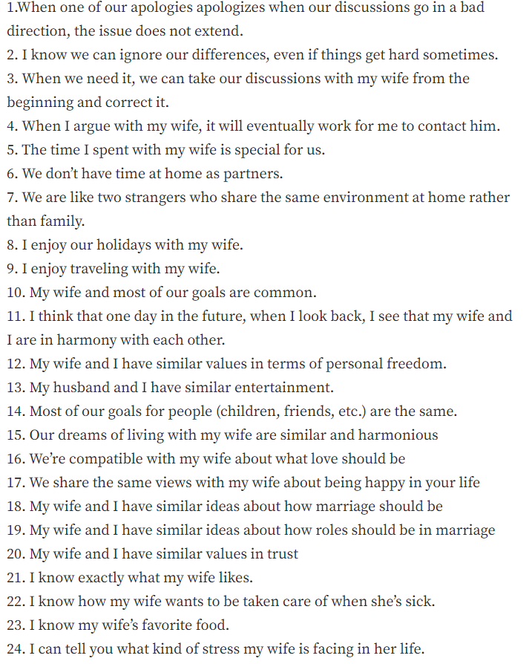
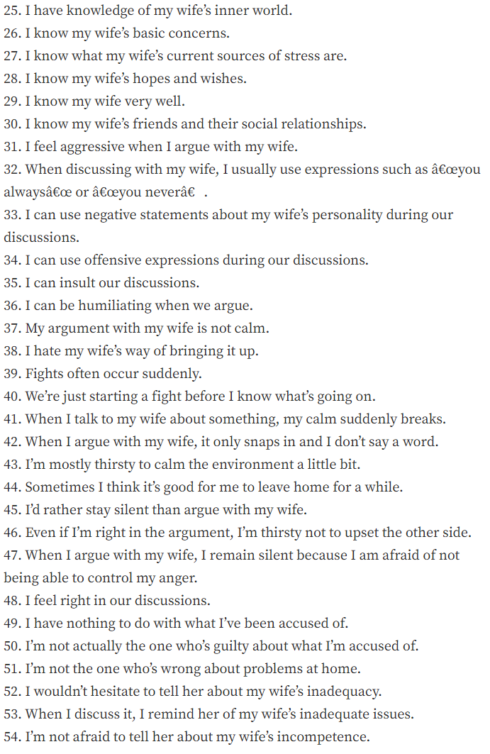

Too many questions
Poorly translated from Turkish
Will need to find better translation after feature selection

Slide 6
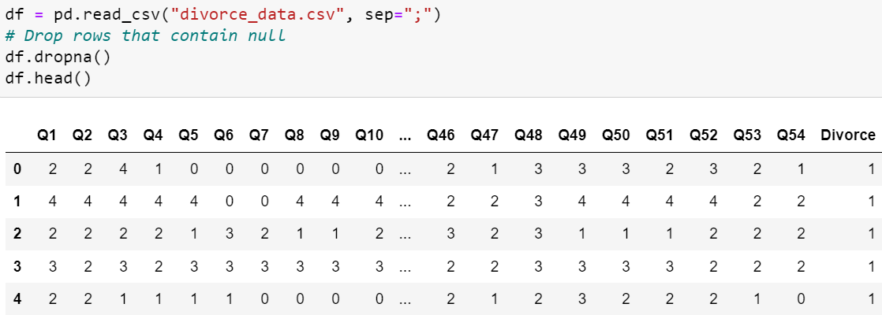
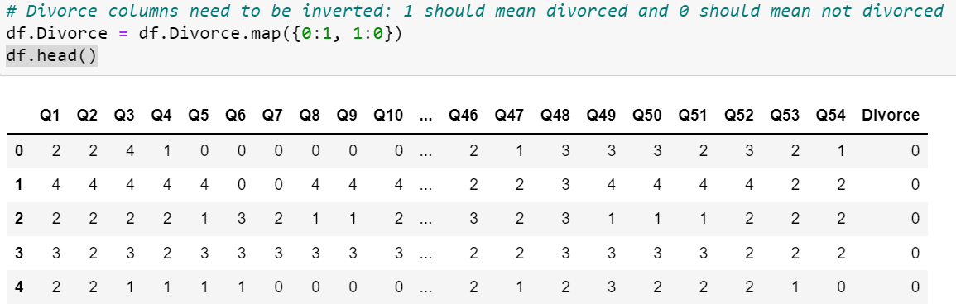
Data Cleaning

Slide 7
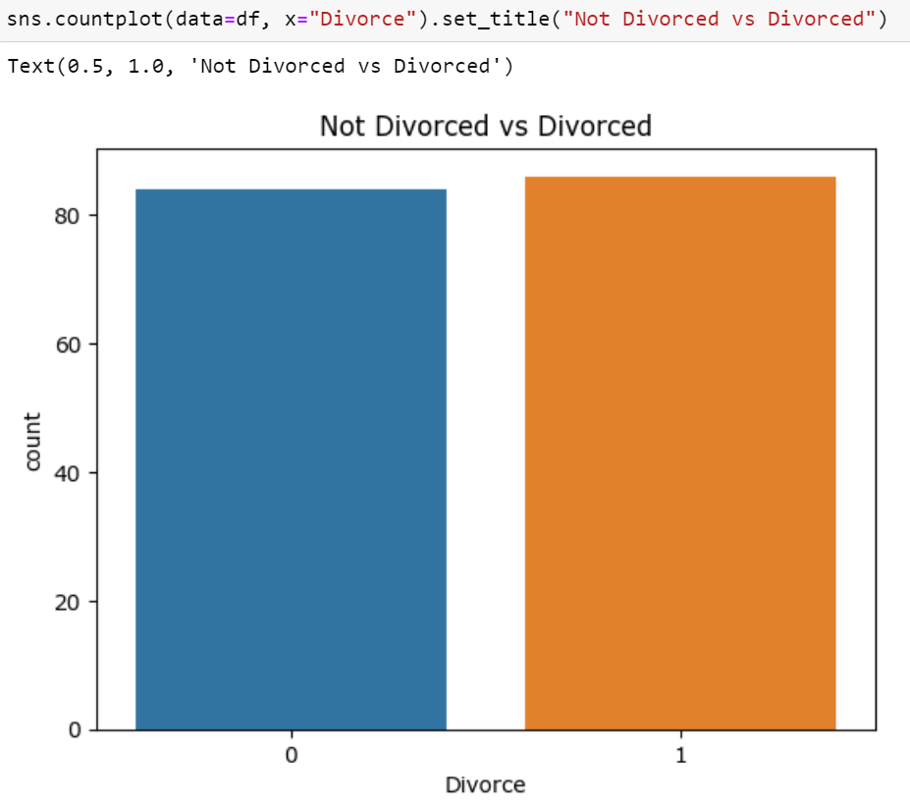
Balanced Classes

Slide 8
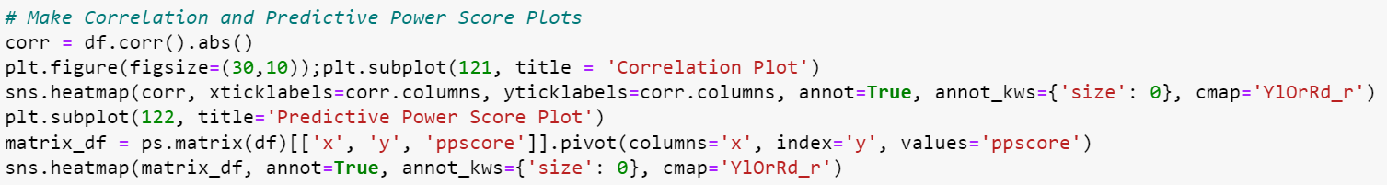
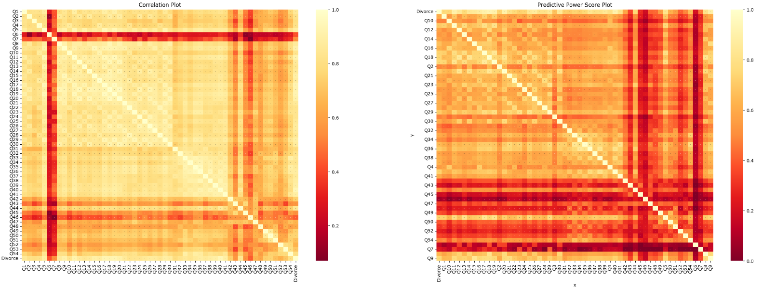
Feature Selection

Slide 9
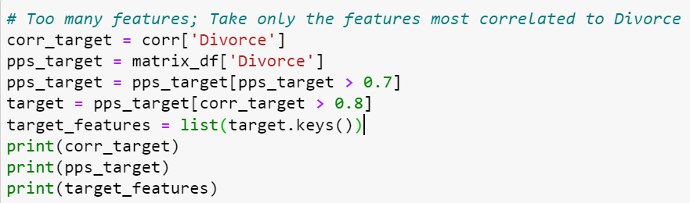
Feature Selection
Q1 0.861324 Q2 0.820774 Q3 0.806709 Q4 0.819583 Q5 0.893180 Q6 0.420913 Q7 0.544835 Q8 0.869569 Q9 0.912368 Q10 0.834897Q11 0.918386 Q12 0.868983 Q13 0.844743 Q14 0.864316 Q15 0.901220 Q16 0.886260 Q17 0.929346 Q18 0.923208 Q19 0.928627 Q20 0.907008 Q21 0.864519 Q22 0.825938 Q23 0.837504 Q24 0.839392 Q25 0.857052 Q26 0.872868 Q27 0.869788 Q28 0.846606 Q29 0.892954 Q30 0.874531 Q31 0.792607 Q32 0.829056 Q33 0.861328 Q34 0.835167 Q35 0.862624 Q36 0.886497 Q37 0.863597 Q38 0.883311 Q39 0.896180 Q40 0.938684 Q41 0.894356 Q42 0.739629 Q43 0.566242 Q44 0.847336 Q45 0.546450 Q46 0.443465 Q47 0.656409 Q48 0.619830 Q49 0.740704 Q50 0.755248 Q51 0.692681 Q52 0.651478 Q53 0.711176 Q54 0.806765 Divorce 1.000000
Name: Divorce, dtype: float64
y Divorce 1.000000 Q17 0.732409 Q18 0.738460 Q19 0.752193 Q20 0.701421 Q29 0.709154 Q36 0.704117 Q40 0.728373 Q5 0.728786 Q9 0.751241
Name: Divorce, dtype: float64
['Divorce', 'Q17', 'Q18', 'Q19', 'Q20', 'Q29', 'Q36', 'Q40', 'Q5', 'Q9']

Slide 10
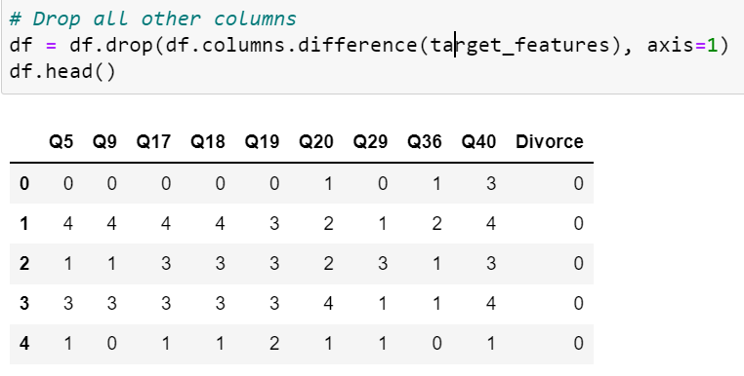
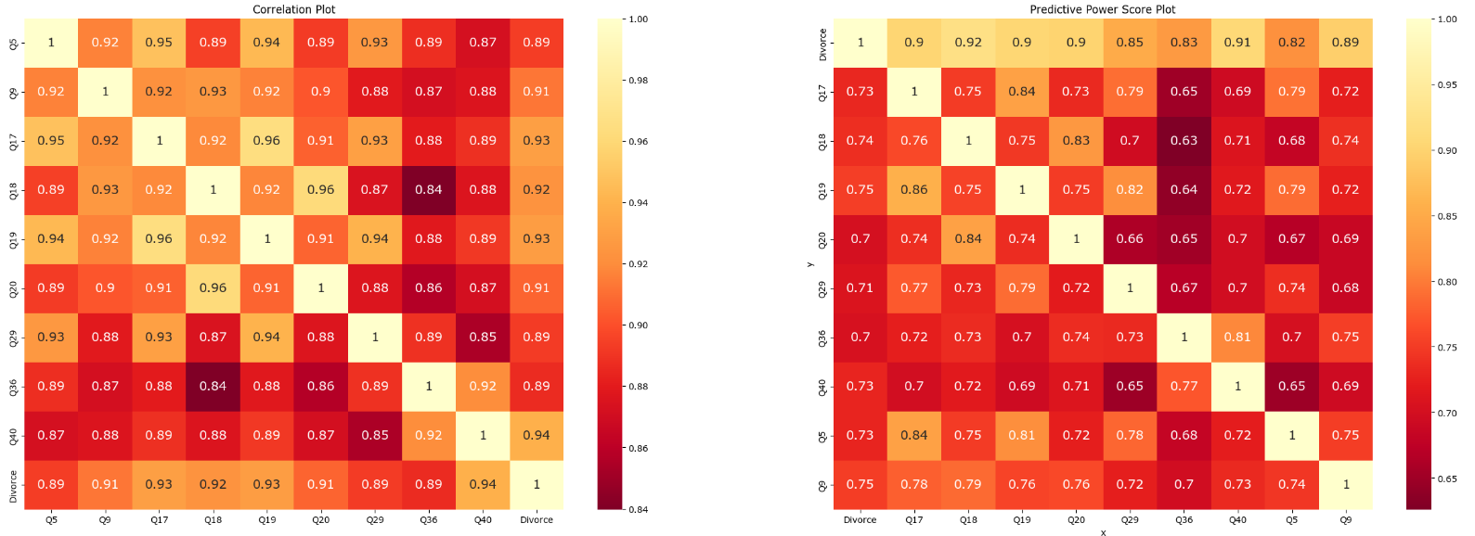
Feature Selection

Slide 11
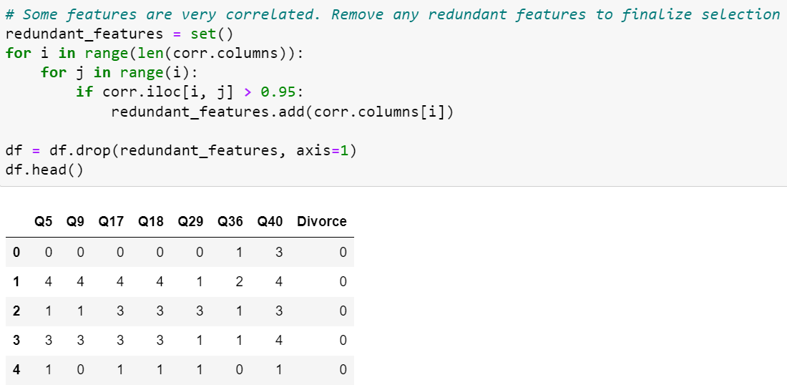
FEATURE selection
Reduce redundancy
Personality questions require a high degree of leniency
Tolerance of 95%
Down to 7 features:
Q5, Q9, Q17, Q18, Q29, Q36, Q40

Slide 12
Re-translaTing Our Features
Before
After
Q5: The time I spent with my wife is special for us.
Q9: I enjoy traveling with my wife.
Q17: We share the same views with my wife about being happy in your life.
Q18: My wife and I have similar ideas about how marriage should be.
Q29: I know my wife very well.
Q36: I can be humiliating when we argue.
Q40: We’re just starting a fight before I know what’s going on.
Q5: The time I spend with my spouse is special for the both of us.
Q9: I look forward to vacations with my spouse and enjoy the travel we do together.
Q17: My spouse and I have similar ideas about how we find happiness in life.
Q18: My spouse and I have similar ideas about how marriage should be.
Q29: I know my spouse very well.
Q36: I am humble in discussions with my spouse.
Q40: I know why my partner is upset before we have an argument.
Redundant Features
Q19 (Redundant with Q17): My wife and I have similar ideas about how roles should be in marriage.
Q20 (Redundant with Q18): My wife and I have similar values in trust.

Slide 13
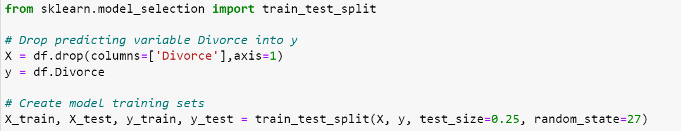
Model TraininG

Slide 14
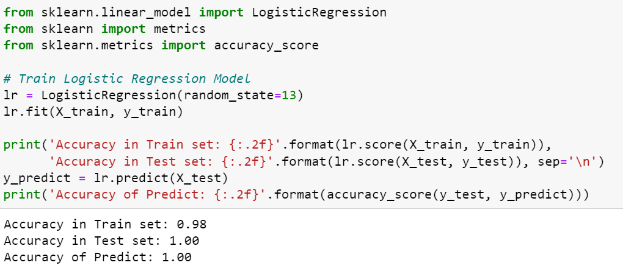
Model 1: Logistic Regression

Slide 15
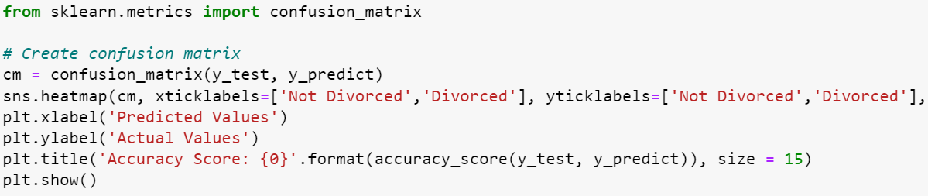
Model Evaluation

Slide 16
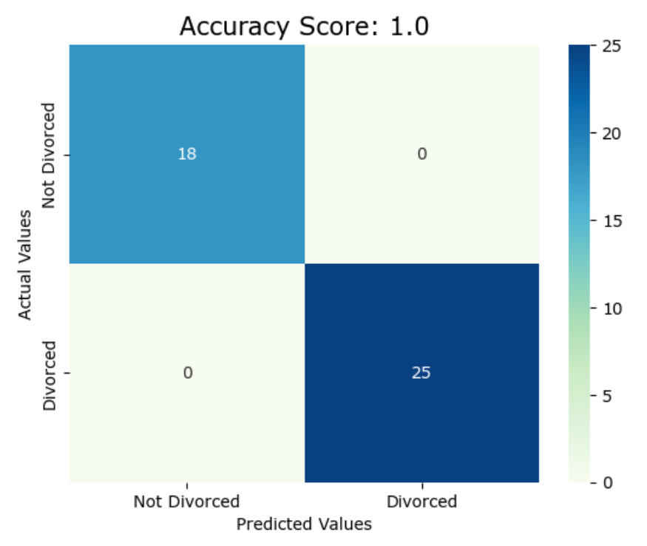
Model 1 Confusion Matrix

Slide 17
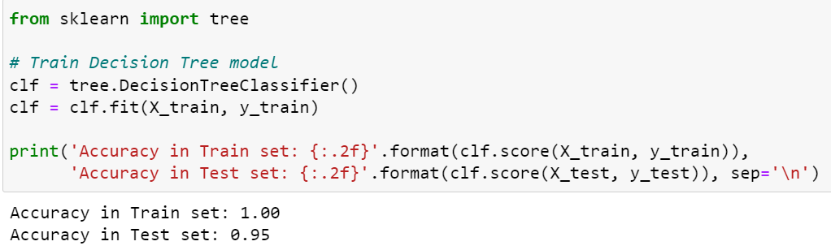
Model 2: DECISION Tree Classifier

Slide 18
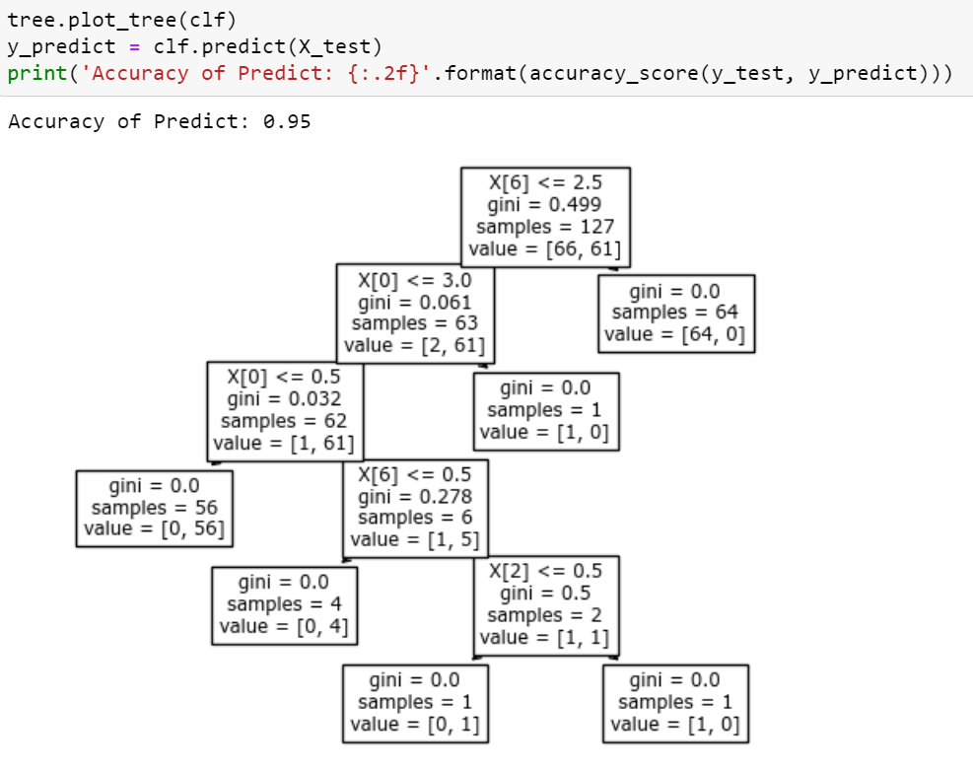
Model 2: DECISION Tree Classifier

Slide 19
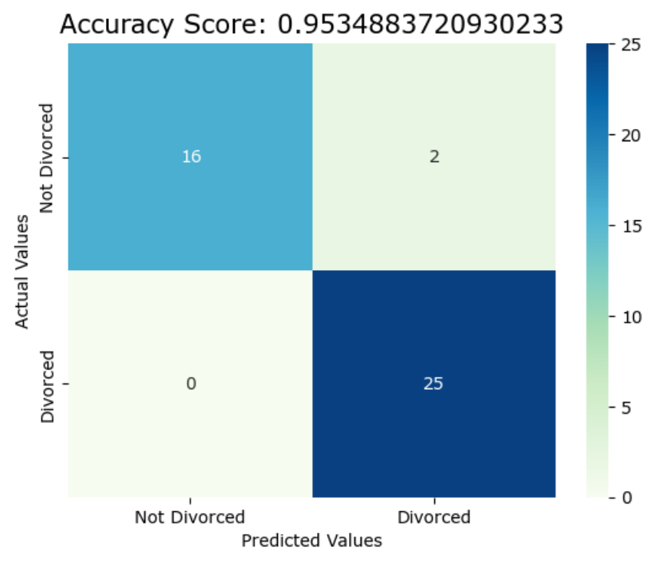
Model 2 Confusion Matrix

Slide 20
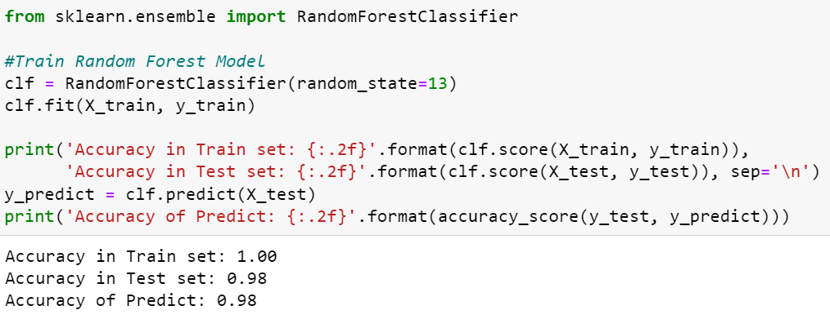
Model 3: RANDOM FOREST Classifier

Slide 21
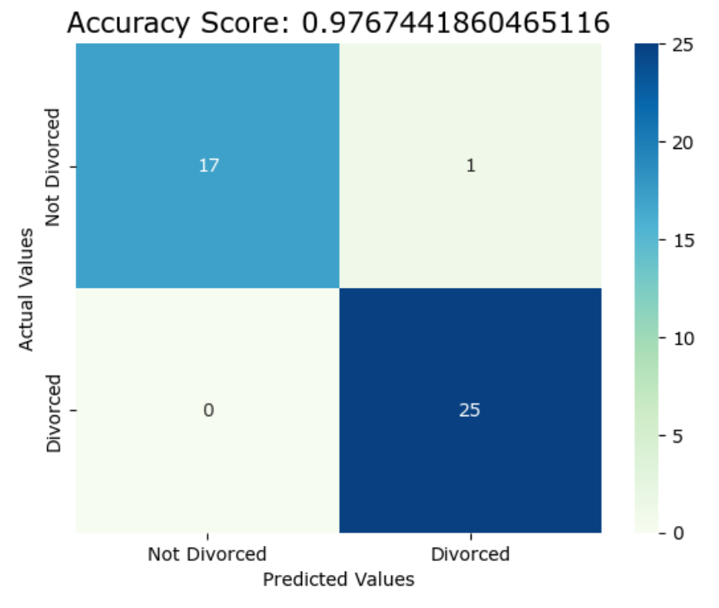
Model 3 Confusion Matrix

Slide 22
Streamlit Model

Slide 23
Conclusions
Good all-around model performance
Logistic Regression had best performance
Many features still had high correlation
Not to be taken too seriously

Slide 24
References
[1] "Divorce Prediction," 30 July 2020. [Online]. Available: https://www.kaggle.com/datasets/andrewmvd/divorce-prediction.
[2] "The Questionnaire," The Gottman Institute, [Online]. Available: https://checkup.gottman.com/couple/questionnaire/intro. [Accessed 1 December 2022].
[3] "sklearn.tree.DecisionTreeClassifier," scikit learn, [Online]. Available: https://scikit-learn.org/stable/modules/generated/sklearn.tree.DecisionTreeClassifier.html. [Accessed 27 November 2022].
[4] "sklearn.metrics.confusion_matrix," scikit learn, [Online]. Available: https://scikit-learn.org/stable/modules/generated/sklearn.metrics.confusion_matrix.html. [Accessed 27 November 2022].
[5] "pandas.Dataframe.pivot," pandas, [Online]. Available: https://pandas.pydata.org/pandas-docs/stable/reference/api/pandas.DataFrame.pivot.html. [Accessed 27 November 2022].
[6] "sklearn.linear_model.LogisticRegression," scikit learn, [Online]. Available: https://scikit-learn.org/stable/modules/generated/sklearn.linear_model.LogisticRegression.html. [Accessed 27 November 2022].
[7] "sklearn.ensemble.RandomForestClassifier," scikit learn, [Online]. Available: https://scikit-learn.org/stable/modules/generated/sklearn.ensemble.RandomForestClassifier.html. [Accessed 27 November 2022].
[8] M. Waskom, "seaborn.heatmap," seaborn, [Online]. Available: https://seaborn.pydata.org/generated/seaborn.heatmap.html. [Accessed 27 November 2022].
[9] U. Malik, "Applying Filter Methods in Python for Feature Selection," Stack Abuse, 30 October 2018. [Online]. Available: https://stackabuse.com/applying-filter-methods-in-python-for-feature-selection/. [Accessed 27 November 2022].
[10] A. Sheyte, "Feature Selection with sklearn and Pandas," Towards Data Science, 11 February 2019. [Online]. Available: https://towardsdatascience.com/feature-selection-with-pandas-e3690ad8504b. [Accessed 27 November 2022].
[11] "st.slider," Streamlit, [Online]. Available: https://docs.streamlit.io/library/api-reference/widgets/st.slider. [Accessed 1 December 2022].
[12] "Create an app," Streamlit, [Online]. Available: https://docs.streamlit.io/library/get-started/create-an-app. [Accessed 1 December 2022].
[13] A. Ortner, "Top 10 Binary Classification Algorithms [a Beginner’s Guide]," Towards Data Science, 28 May 2022. [Online]. Available:
https://towardsdatascience.com/top-10-binary-classification-algorithms-a-beginners-guide-feeacbd7a3e2. [Accessed 26 November 2022].
[14] M. Waskom, "seaborn.countplot," seaborn, [Online]. Available: https://seaborn.pydata.org/generated/seaborn.countplot.html. [Accessed 27 November 2022].
[15] S. S. Skiena, The Data Science Design Manual, Stony Brook: Springer International Publishing AG, 2017.
[16] J. VanderPlas, Python Data Science Handbook: Essential Tools for Working with Data, Sebastopol: O'Reilly Media, Inc., 2016.
[17] “ppscore 1.3.0," PyPI, [Online]. Available: https://pypi.org/project/ppscore/. [Accessed 27 November 2022].

